Slide 1
Image noise
It refers to random variations in pixel values that are not part of the actual image content. It can distort or degrade the quality of an image, making it look grainy or pixelated. Image noise typically arises due to various factors during image capture or processing.

Slide 2
Causes of Noise in Image Processing
Environmental Conditions: External factors such as poor lighting or nearby electronic interference commonly cause noise in images. They can add random variations in images.
Sensor Noise: Any issues with the sensor used in cameras and scanners can add to noise in images. For example, in poor lighting conditions, if you’re not using a good quality sensor, it can amplify the noise along with the light.
Quantization Noise: Occurs when analog signals are converted to digital form, particularly in high-contrast images. For example, when you scan a photograph, you’ll often see noise appear in the resulting image. This is quantization noise appearing from image digitization.
Transmission Noise: Occurs when images are transmitted over noisy channels, be it through networks (e.g., the internet) or stored on noisy storage media (like hard drives).
Processing Noise: Occurs during image processing operations, such as filtering, compression, etc.

Slide 3
Noise Measurement
In image analysis, noise assessment and evaluation is a fundamental task. It involves quantifying the level of noise in an image. This process relies on two primary noise measurement techniques:
Peak Signal-to-Noise Ratio (PSNR): PSNR serves as a benchmark for evaluating the quality of image reconstruction. It compares the pixel values of the original image to those of the reproduced image, providing a numerical measure of how faithfully the image is reproduced.
Mean Squared Error (MSE): MSE, in contrast, assesses the differences between the pixel values of two images. This method calculates the average of the squared differences between corresponding pixels in the two images. This quantitative approach helps us understand the extent of noise in an image and its impact on quality.

Slide 4
There are several types of image noise:
1. Gaussian Noise
2. Salt and Pepper Noise
3. Poisson Noise (Photon Shot Noise)
4. Speckle Noise
5. Quantization Noise
6. Thermal Noise

Slide 5
1. Gaussian Noise
Description: It’s one of the most common types of noise in images. The noise follows a Gaussian distribution, meaning it appears as random variations in pixel values with a bell-curve probability.
Cause: It often results from sensor imperfections or environmental conditions, such as low-light situations.
Visual Effect: It appears as fine-grained random variations in pixel values.
Gaussian noise is modeled by a normal (Gaussian) distribution. The equation for Gaussian noise is:
Inoisy(x,y)=Iclean(x,y)+N(0,σ2)
Inoisy​(x,y) is the noisy pixel value at position (x,y)(x, y)(x,y).

Slide 6
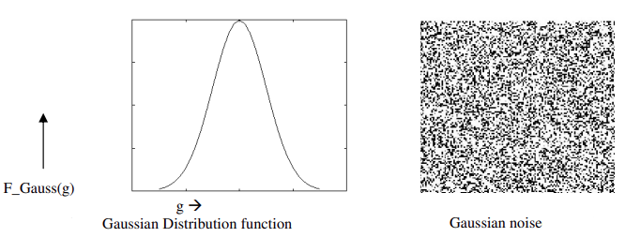

Slide 7
2. Salt and Pepper Noise
Description: This noise consists of randomly occurring white and black pixels scattered across the image, resembling salt-and-pepper grains.
Cause: It typically occurs due to sensor malfunction or transmission errors, where some pixels are overexposed (salt) or underexposed (pepper).
Visual Effect: It appears as small dots of black and white pixels scattered across the image.

Slide 8

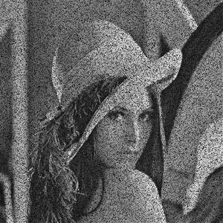
Salt noise Paper noise
Salt noise refers to white spots or dots that appear erratically in digital images. These pixels all have a maximum intensity value of 255, which is typical of an 8-bit gray scale image.
Pepper noise, on the other hand, refers to random black spots or pixels occurring in a digital image.

Slide 9
3. Poisson Noise (Photon Shot Noise)
Description: Poisson noise occurs due to the discrete nature of light, where the photon count is low, and the sensor might detect fewer photons than expected, causing fluctuations. Poisson noise is produced by the image detectors’ and recorders’ nonlinear responses.
Cause: It’s often seen in low-light environments or with long exposure times.
Visual Effect: It appears as variations in brightness that can make parts of the image seem noisy or speckled.

Slide 10
4. Speckle Noise
Description: Speckle noise manifests as grainy patterns or specks throughout the image. It's similar to salt-and-pepper noise but is typically more uniform and closely packed.
Cause: It can be caused by issues in the image sensor or by interference from other signals.
Visual Effect: It looks like random grainy dots in the image.

Slide 11
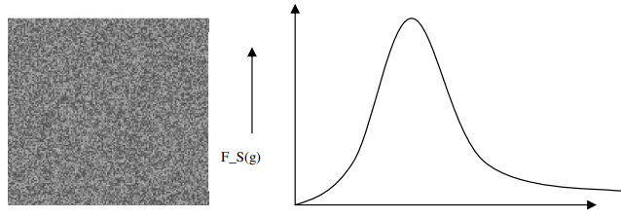

Slide 12
5. Quantization Noise
Description: This occurs when an image is converted from a higher bit depth to a lower one, causing small errors in pixel value representation.
Cause: Often happens during digital conversion processes, such as in JPEG compression or reducing the bit depth for storage.
Visual Effect: This can cause a blocky or blurry appearance due to a reduction in color or pixel precision.

Slide 13
6. Thermal Noise
Description: Caused by the random motion of charge carriers (electrons) in the image sensor due to temperature, often appearing as small variations in pixel values.
Cause: Typically occurs in low-light conditions or when using sensors with high exposure.
Visual Effect: It can appear as random pixel variations in both color and brightness.

Slide 14
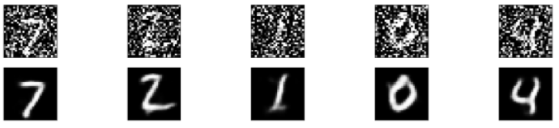
Image Denoising using Autoencoders
Another commonly used approach for denoising is with autoencoders which is an used to compress and decompress data by leveraging encoders and decoders in a supervised manner. To use autoencoders for denoising, train the encoders and decoders with noisy images as to features, and cleaned images as targets.

Slide 15
Common Noise Reduction Techniques
Median Filtering: To eliminate impulse noise, median filtering substitutes the pixel's value with the median values of its nearby pixels.
Gaussian Filtering: This technique replaces each pixel in an image with a weighted average of the pixels in a neighborhood of pixels around that pixel.
Bilateral Filtering: This technique combines the median and Gaussian filtering to reduce noise with intact edges.
Wavelet Filtering: This technique uses the Fourier Transform model to pass image wavelet coefficients to reduce noise.
Denoising Autoencoders: For more advanced noise reduction, deep learning techniques like denoising autoencoders can be used, which are trained to learn how to remove noise from images.

Slide 16
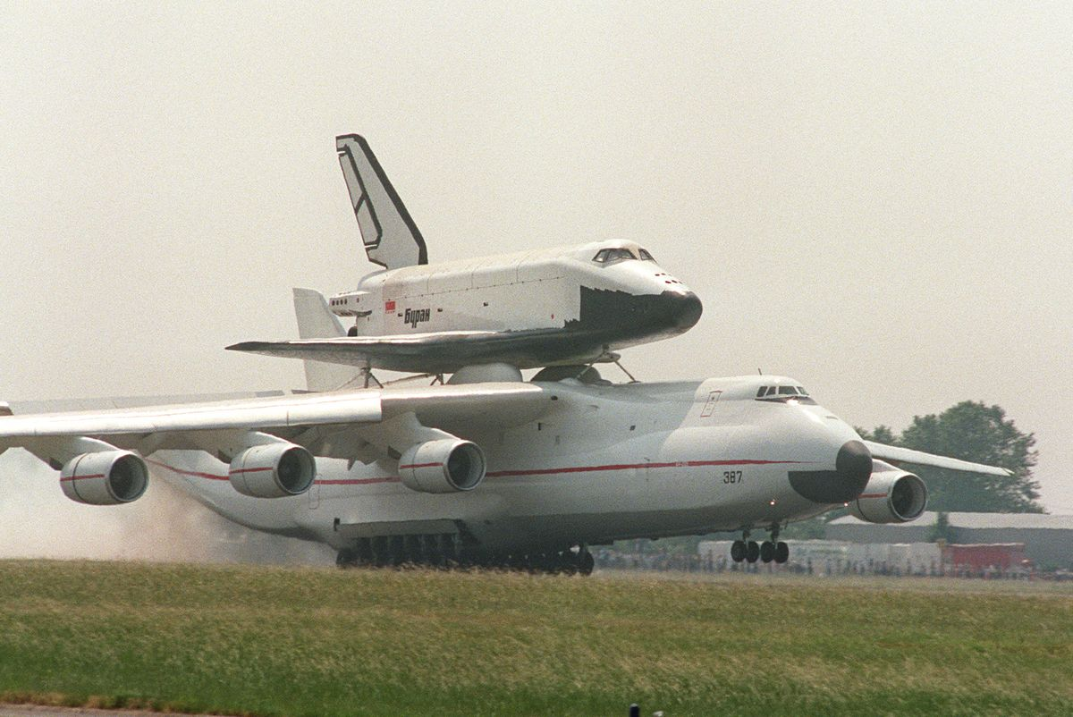
Effect of Gaussian Filtering

Slide 17
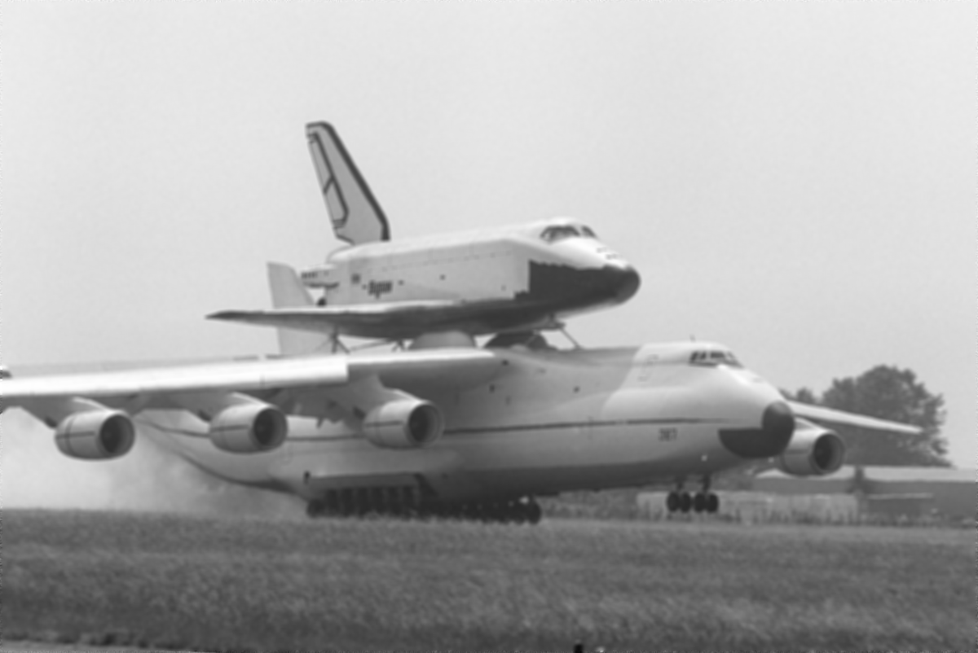
And the result of the Gaussian Blur with σ=3
And the result of the Gaussian Blur with σ=3

